Slide 1
Chapter 6
The Relational Algebra

Slide 2
Chapter 6 Outline
Unary Relational Operations: SELECT and PROJECT
Relational Algebra Operations from Set Theory
Binary Relational Operations: JOIN and DIVISION
Examples of Queries in Relational Algebra

Slide 3
The Relational Algebra and
Relational Calculus
The relational algebra is very important for several reasons:
First, it provides a formal foundation for relational model operations.
Second, and perhaps more important, it is used as a basis for implementing and optimizing queries in the query processing and optimization modules that are integral parts of relational database management systems (RDBMSs).
Third, some of its concepts are incorporated into the SQL standard query language for RDBMSs.

Slide 4
The Relational Algebra and
Relational Calculus
Relational algebra
  Basic set of operations for the relational model
Relational algebra expression
  Sequence of relational algebra operations
Relational calculus
  Higher-level declarative language for specifying relational queries
  A relational calculus expression creates a new relation

Slide 5
The relational algebra operations can be divided into two groups.
One group includes set operations from mathematical set theory: UNION, INTERSECTION, SET DIFFERENCE, and CARTESIAN PRODUCT (also known as CROSS PRODUCT)
The other group consists of operations developed specifically for relational databases—these include SELECT, PROJECT, and JOIN, among others.
unary operations SELECT and PROJECT that operate on single relations.
binary operations JOIN which operate on two tables by combining related tuples (records) based on join conditions.

Slide 6


Unary Relational Operations:
SELECT and PROJECT
The SELECT Operation
  This operation is used to choose a Subset of the tuples from a relation that satisfies a selection condition:
    Boolean expression contains clauses of the form <attribute name> <comparison op> <constant value>
    or
    <attribute name> <comparison op> <attribute name>
    <comparison op> can be one of

Slide 7
Unary Relational Operations:
SELECT and PROJECT (cont’d.)
Example:
<selection condition> applied independently to each individual tuple t in R
  If condition evaluates to TRUE, tuple selected
Boolean conditions AND, OR, and NOT
Unary
  Applied to a single relation

Slide 8
Unary Relational Operations:
SELECT and PROJECT (cont’d.)
The Boolean conditions AND, OR, and NOT have their normal interpretation, as follows:
(cond1 AND cond2) is TRUE if both (cond1) and (cond2) are TRUE; other wise, it is FALSE.
(cond1 OR cond2) is TRUE if either (cond1) or (cond2) or both are TRUE; otherwise, it is FALSE.
(NOT cond) is TRUE if cond is FALSE; otherwise, it is FALSE.

Slide 9
Unary Relational Operations:
SELECT and PROJECT (cont’d.)
Selectivity
  Fraction of tuples selected by a selection condition
SELECT operation commutative
Cascade SELECT operations into a single operation with AND condition

Slide 10
Unary Relational Operations:
SELECT and PROJECT (cont’d.)
In SQL, the SELECT condition is typically specified in the WHERE clause of a query.
For example, the following operation: σ <Dno=4> AND <Salary>2500> (EMPLOYEE)
would correspond to the following SQL query: SELECT * FROM EMPLOYEE WHERE Dno=4 AND Salary>25000;

Slide 11

The PROJECT Operation
If we think of a relation as a table, the SELECT operation chooses some of the rows from the table while discarding other rows.
The PROJECT operation, on the other hand, selects certain columns from the table and discards the other columns:
Degree
  Number of attributes in <attribute list>
Duplicate elimination
  Result of PROJECT operation is a set of distinct tuples

Slide 12
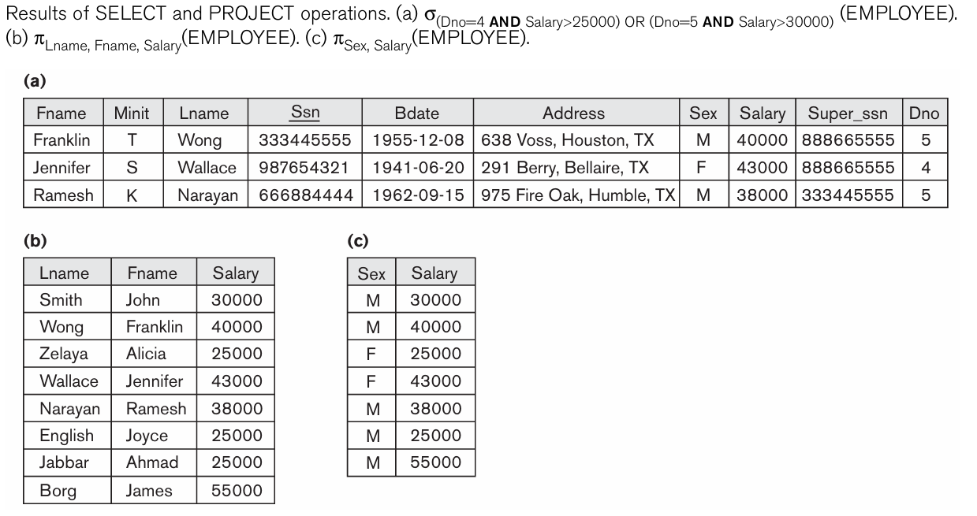

Slide 13


Sequences of Operations and the RENAME Operation
Either we can write the operations as a single relational algebra expression by nesting the operations, or we can apply one operation at a time and create intermediate result relations
For example, to retrieve the first name, last name, and salary of all employees who work in department number 5, we must apply a SELECT and a PROJECT operation.
In-line expression:
Sequence of operations:
Rename attributes in intermediate results
  RENAME operation

Slide 14

Sequences of Operations and the RENAME Operation
Rename attributes in intermediate results
  RENAME operation
To rename the attributes in a relation, we simply list the new attribute names in parentheses, as in the following example:

Slide 15
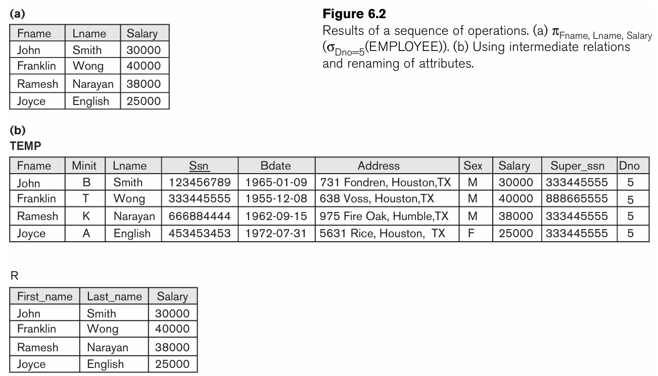

Slide 16
Relational Algebra Operations from Set Theory
Several set theoretic operations are used to merge the elements of two sets in various ways, including UNION, INTERSECTION, and SET DIFFERENCE (also called MINUS or EXCEPT).
Two relations R(A1, A2, ...,An) and S(B1, B2, ...,Bn) are said to be union compatible (or type compatible) if they have the same degree n and if dom(Ai) = dom(Bi) for 1<= i<= n.
This means that the two relations have the same number of attributes and each corresponding pair of attributes has the same domain.

Slide 17
Relational Algebra Operations from Set Theory
UNION
  R ∪ S
  Includes all tuples that are either in R or in S or in both R and S
  Duplicate tuples eliminated

Slide 18
Relational Algebra Operations from Set Theory (cont’d.)
INTERSECTION
  R ∩ S
  Includes all tuples that are in both R and S
SET DIFFERENCE (or MINUS)
  R – S
  Includes all tuples that are in R but not in S

Slide 19
Example Question
Retrieve the Social Security numbers of all employees who either work in department 5 or directly supervise an employee who works in department 5

Slide 20
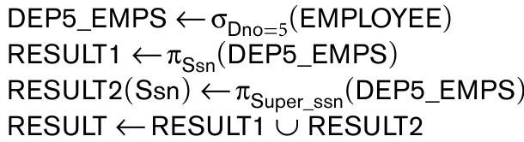
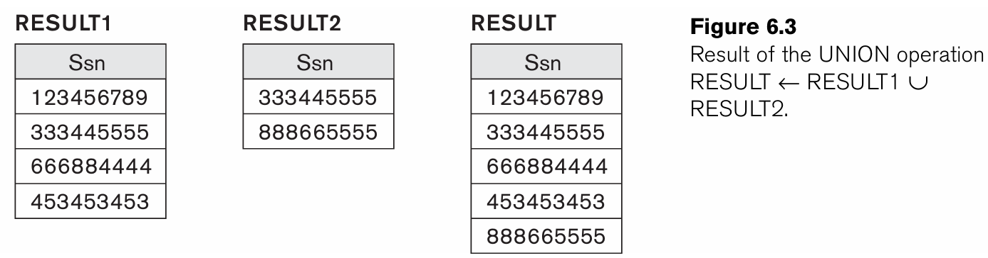

Slide 21
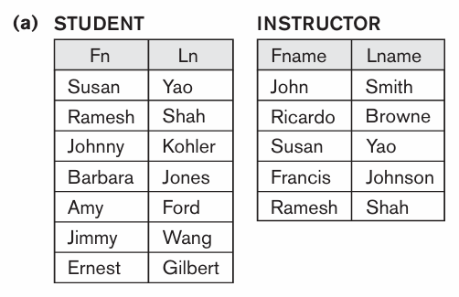
Two Union compatible relations

Slide 22
Find out the following:
STUDENT ∪ INSTRUCTOR
STUDENT ∩ INSTRUCTOR
STUDENT − INSTRUCTOR
INSTRUCTOR − STUDENT

Slide 23
Note the following laws
UNION and INTERSECTION are commutative operations;
    that is, R ∪S=S∪R and R∩S=S∩R
Both UNION and INTERSECTION can be treated as n-ary operations applicable to any number of relations because both are also associative operations;
    that is, R ∪(S∪T)=(R∪S)∪T and (R∩S)∩T=R∩(S∩T)
The MINUSoperation is not commutative;
    that is, in general, R −S≠S−R
INTERSECTION can be expressed in terms of union and set difference as follows:
    R ∩S=((R∪S)−(R−S))−(S−R)

Slide 24
The CARTESIAN PRODUCT (CROSS PRODUCT) Operation
CARTESIAN PRODUCT
  CROSS PRODUCT or CROSS JOIN
  Denoted by ×
  Binary set operation
  Relations do not have to be union compatible
  In general, the result of R(A1, A2, ..., An) × S(B1, B2, ..., Bm) is a rela tion Q with degree n + m attributes Q(A1, A2, ..., An, B1, B2, ..., Bm), in that order. The resulting relation Q has one tuple for each combination of tuples—one from R and one from S.
  Hence, if R has nR tuples (denoted as |R| = nR), and S has nS tuples, then R × S will have nR * nS tuples.

Slide 25
The CARTESIAN PRODUCT (CROSS PRODUCT) Operation
In general, the CARTESIAN PRODUCT operation applied by itself is generally meaningless. It is mostly useful when followed by a selection that matches values of attributes coming from the component relations.
For example, suppose that we want to retrieve a list of names of each female employee’s dependents.

Slide 26
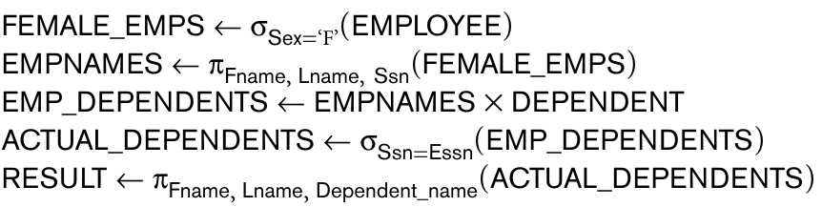
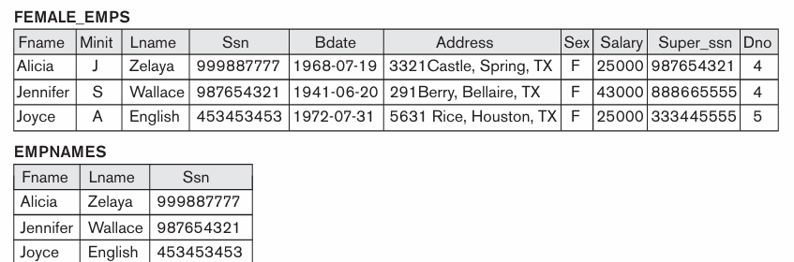

Slide 27
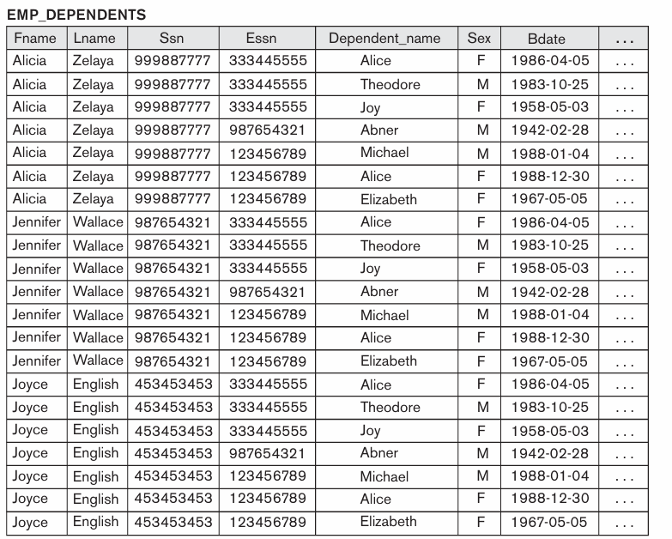

Slide 28
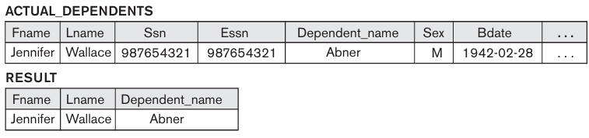

Slide 29



Binary Relational Operations:
JOIN and DIVISION
The JOIN Operation
  Denoted by that is where R and S are two relations
  Combine related tuples from two relations into single “longer” tuples
  General join condition of the form <condition> AND <condition> AND...AND <condition>
  Example:

Slide 30
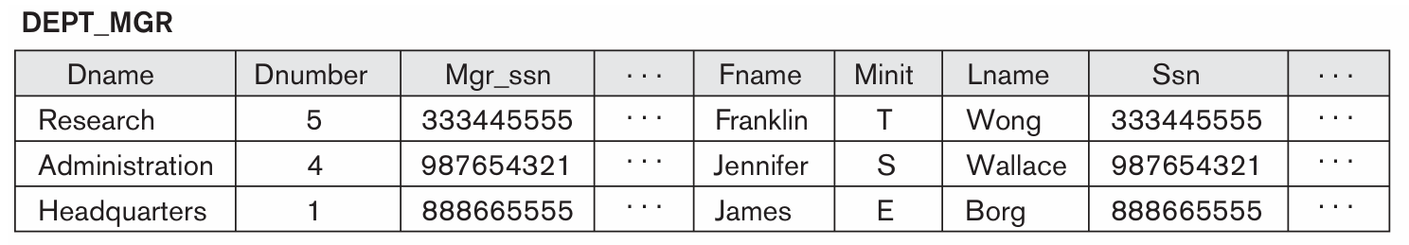
The JOIN operation can be specified as a CARTESIAN PRODUCT operation followed by a SELECT operation.
In JOIN, only combinations of tuples satisfying the join condition appear in the result, whereas in the CARTESIAN PRODUCT all combinations of tuples are included in the result.

Slide 31
Binary Relational Operations:
JOIN and DIVISION (cont’d.)
THETA JOIN
  Each <condition> of the form A_{i} θ B_{j}
  A_{i} is an attribute of R
  B_{j} is an attribute of S
  A_{i} and B_{j} have the same domain
  θ (theta) is one of the comparison operators:
    {=, <, ≤, >, ≥, ≠}

Slide 32
Variations of JOIN: The EQUIJOIN and NATURAL JOIN
EQUIJOIN
  Only = comparison operator used
  Always have one or more pairs of attributes that have identical values in every tuple
NATURAL JOIN
  Denoted by *
  Removes second (superfluous) attribute in an EQUIJOIN condition
  requires that the two join attributes (or each pair of join attributes) have the same name in both relations. If this is not the case, a renaming operation is applied first.

Slide 33
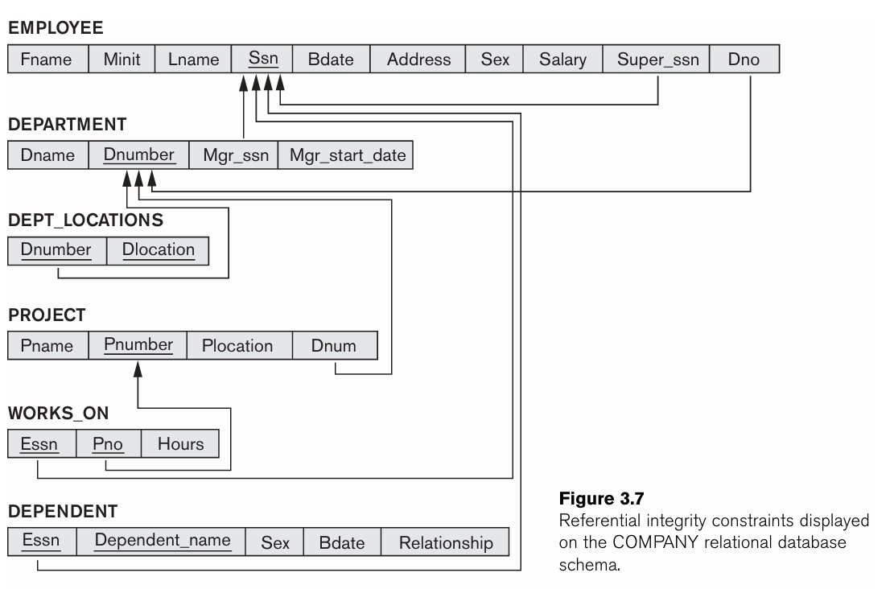

Slide 34

Suppose we want to combine each PROJECT tuple with the DEPARTMENT tuple that controls the project.
First we rename the Dnumber attribute of DEPARTMENT to Dnum—so that it has the same name as the Dnum attribute in PROJECT—and then we apply NATURAL JOIN:
The attribute Dnum is called the join attribute for the NATURAL JOIN operation,

Slide 35
Variations of JOIN: The EQUIJOIN and NATURAL JOIN (cont’d.)
the result of a JOIN operation will have between zero and nR*nS tuples.
The expected size of the join result divided by the maximum size nR*nS leads to a ratio called join selectivity, which is a property of each join condition.
Inner joins
  Defined formally as a combination of CARTESIAN PRODUCT and SELECTION

Slide 36
The NATURAL JOIN or EQUIJOIN operation can also be specified among multiple tables, leading to an n-way join.

Slide 37
The DIVISION Operation
Denoted by ÷
Example: retrieve the names of employees who work on all the projects that ‘John Smith’ works on
Apply to relations R(Z) ÷ S(X)
  Attributes of R are a subset of the attributes of S

Slide 38
The DIVISION Operation
An example is : Retrieve the names of employees who work on all the projects that ‘John Smith’ works on.

Slide 39


The DIVISION Operation
First, retrieve the list of project numbers that ‘John Smith’ works on in the intermediate relation SMITH_PNOS:
create a relation that includes a tuple whenever the employee whose Ssn is Essn works on the project whose number is Pno in the intermediate relation SSN_PNOS:
Finally, apply the DIVISION operation to the two relations, which gives the desired employees ’Social Security numbers:

Slide 40
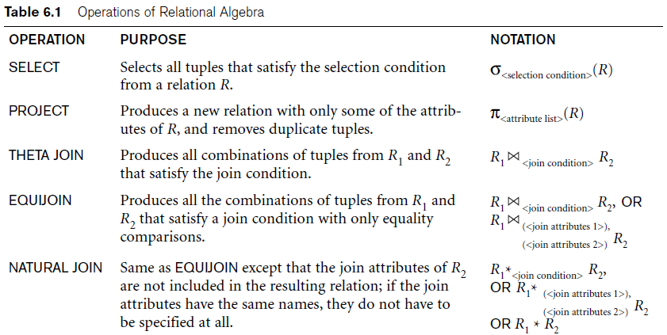
Operations of Relational Algebra

Slide 41
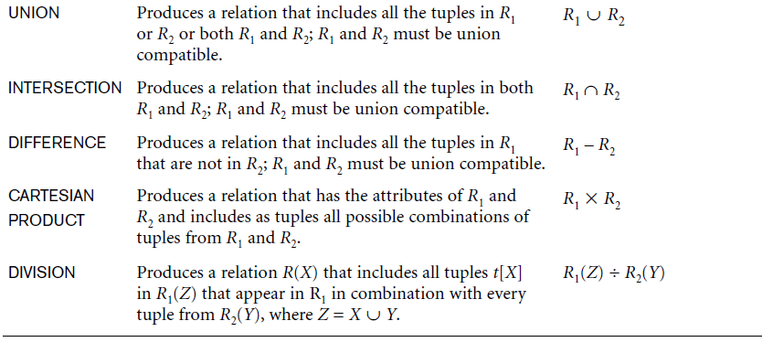
Operations of Relational Algebra (cont’d.)

Slide 42
Notation for Query Trees
Query tree
  Represents the input relations of query as leaf nodes of the tree
  Represents the relational algebra operations as internal nodes

Slide 43
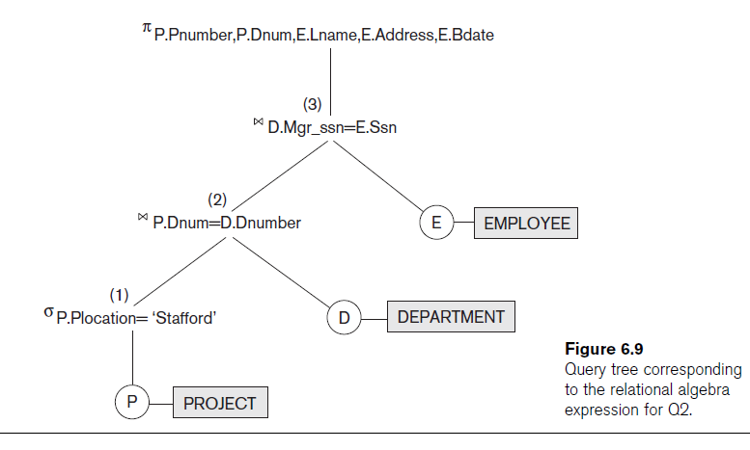

Slide 44

Additional Relational Operations
Generalized projection
  Allows functions of attributes to be included in the projection list
Aggregate functions and grouping
  Common functions applied to collections of numeric values
  Include SUM, AVERAGE, MAXIMUM, and MINIMUM

Slide 45

Additional Relational Operations (cont’d.)
Group tuples by the value of some of their attributes
  Apply aggregate function independently to each group

Slide 46
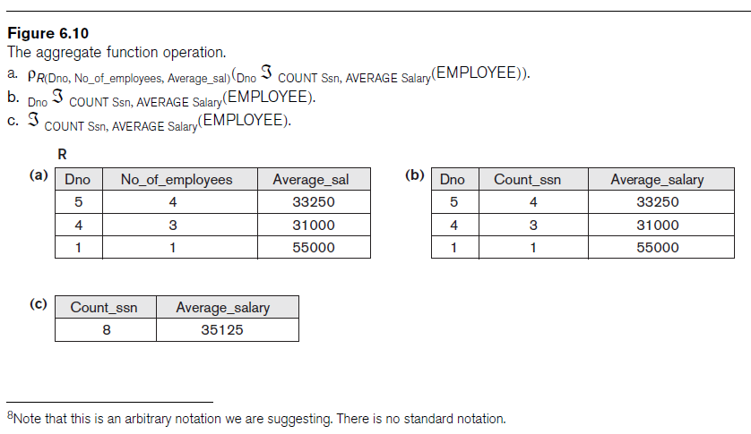

Slide 47
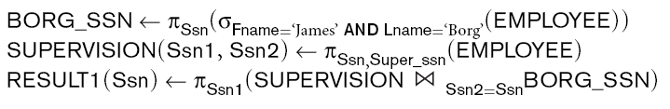
Recursive Closure Operations
Operation applied to a recursive relationship between tuples of same type

Slide 48
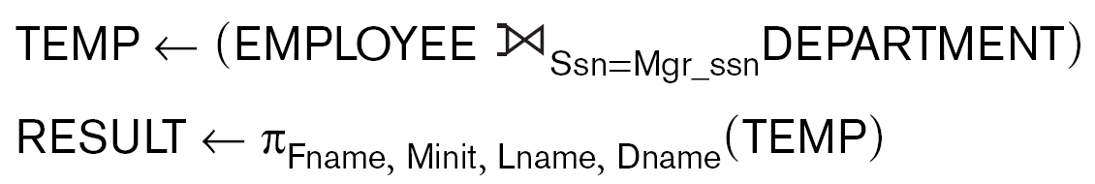
OUTER JOIN Operations
Outer joins
  Keep all tuples in R, or all those in S, or all those in both relations regardless of whether or not they have matching tuples in the other relation
  Types
    LEFT OUTER JOIN, RIGHT OUTER JOIN, FULL OUTER JOIN
  Example:

Slide 49
The OUTER UNION Operation
Take union of tuples from two relations that have some common attributes
  Not union (type) compatible
Partially compatible
  All tuples from both relations included in the result
  Tut tuples with the same value combination will appear only once

Slide 50
Examples of Queries in Relational Algebra

Slide 51
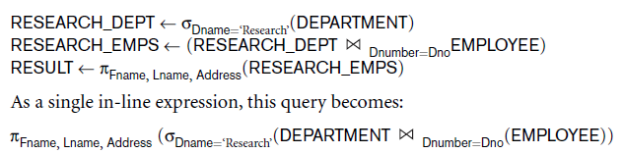
Examples of Queries in Relational Algebra

Slide 52
Examples of Queries in Relational Algebra (cont’d.)
Query 2. For every project located in ‘Stafford’, list the project number, the controlling department number, and the department manager’s last name, address, and birth date.

Slide 53
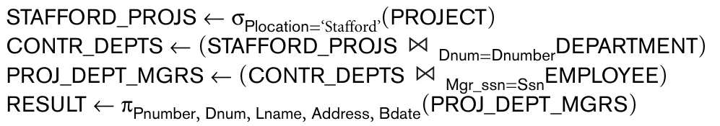
Examples of Queries in Relational Algebra (cont’d.)
Query 2. For every project located in ‘Stafford’, list the project number, the controlling department number, and the department manager’s last name, address, and birth date.

Slide 54
Examples of Queries in Relational Algebra (cont’d.)
Query 2. Find the names of employees who work on all the projects controlled by department number 5.

Slide 55
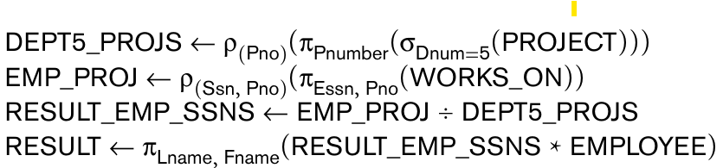
Examples of Queries in Relational Algebra (cont’d.)
Query 2. Find the names of employees who work on all the projects controlled by department number 5.

Slide 56
Examples of Queries in Relational Algebra (cont’d.)
Query 3. Find the names of employees who work on all the projects controlled by department number 5.

Slide 57
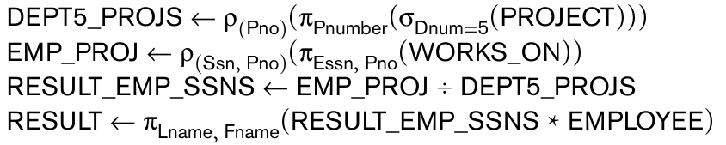
Examples of Queries in Relational Algebra (cont’d.)
Query 3. Find the names of employees who work on all the projects controlled by department number 5.

Slide 58
Examples of Queries in Relational Algebra (cont’d.)
Query 4. Make a list of project numbers for projects that involve an employee whose last name is ‘Smith’, either as a worker or as a manager of the department that controls the project.

Slide 59
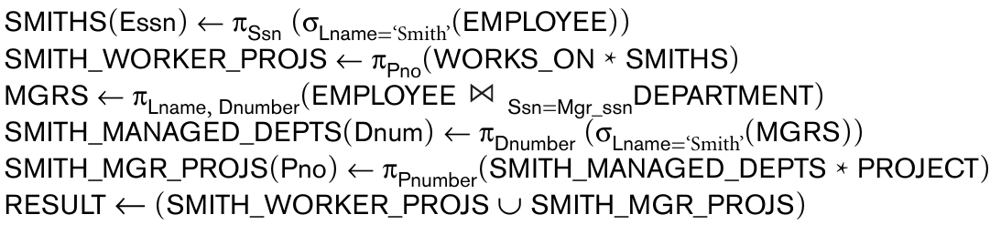
Examples of Queries in Relational Algebra (cont’d.)
Query 4. Make a list of project numbers for projects that involve an employee whose last name is ‘Smith’, either as a worker or as a manager of the department that controls the project.

Slide 60
Examples of Queries in Relational Algebra (cont’d.)
Query 5. Retrieve the names of employees who have no dependents.

Slide 61
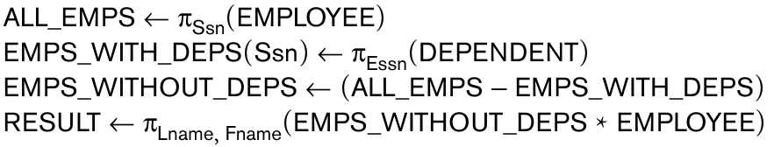
Examples of Queries in Relational Algebra (cont’d.)
Query 5. Retrieve the names of employees who have no dependents.

Slide 62
Examples of Queries in Relational Algebra (cont’d.)
Query 7. List the names of managers who have at least one dependent.

Slide 63
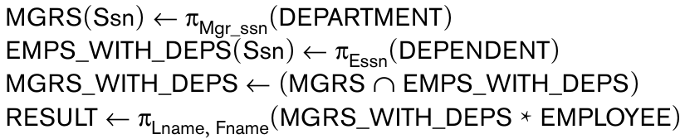
Examples of Queries in Relational Algebra (cont’d.)
Query 7. List the names of managers who have at least one dependent.

